Slide 1

Big Mountain Resort Project
Zhaoqi Fan

Slide 2
Outline
Problem identification
Recommendation and key findings
Modeling results and analysis
Summary and conclusion

Slide 3
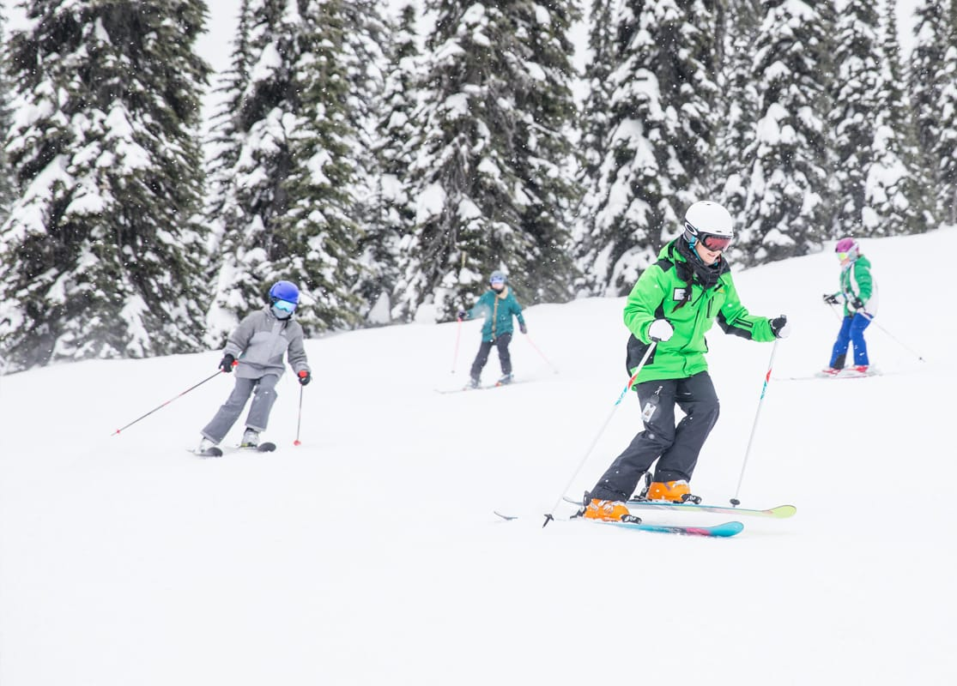
Problem identification
Every year about 350,000 people ski or snowboard at Big Mountain Resort (renamed as Whitefish Mountain Resort now), a ski resort located in Montana.
Big Mountain Resort has recently installed an additional chair lift to help increase the distribution of visitors across the mountain. This additional chair increases their operating costs by $1,540,000 this season.
The business wants some guidance on:
how to select a better value for their ticket price to cover the additional operating costs.
changes that will either cut costs without undermining the ticket price or will support an even higher ticket price.

Slide 4
Problem identification
Problem statement
What opportunities exist for Big Mountain Resort increase the revenue by at least 1.54 million in this season by cutting cost or lifting the ticket price?
Criteria for success
The Big Mountain Resort increase the revenue by at least 1.54 million in this season.
Scope of solution space
The fucus will be primarily put on lifting ticket price or managing the operation of chairlifts.
Constraints within solution space
Operational costs of facilities are not specified.
There is no specific number of visitors and duration in the resort.
Key data sources
A single CSV file - containing information from 330 resorts including Big Mountain Resort in the US

Slide 5
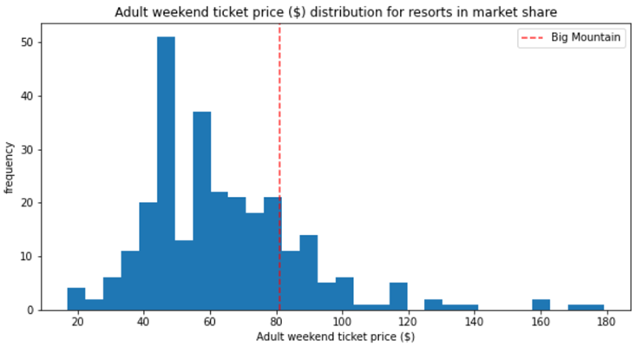
Recommendation and key findings
Recommendation
increase the vertical drop by adding a run to a point 150 feet lower down and
install an additional chair lift to bring skiers back up.
Adult weekend price:
$81.00 increases to $82.99
Revenue increase :
3.47 million
key findings
8 important features related to the ticket price.
Model predicted price is much higher than current price
Vertical drop
Snow making acres
Total chairs
Fast Quads
Runs
Longest Run miles
trams
Skiable Terrain acres
Model predicted
price $95.87

Slide 6
Modeling results and analysis
Data Wrangling
- collecting resort data and state data (area, population, etc.)
Exploratory data analysis
- resort data from all states are used in this project
Pre-processing and Training
- linear and random forest models are trained and tested on clean data (ticket price vs. other features).
- Random forest model is selected to predict ticket price because of its superiority.
 | Linear model | random forest regressor
R² mean | 0.63 | 0.70
R² std | 0.10 | 0.06
Mean absolute error – train split | 10.50 | 9.64
Mean absolute error – test split | 11.80 | 9.54
Modeling
- Refining the random forest model with all available data.
- Identifying key features related to ticket price
- Compare Big Mountain Resort with other resorts on key features.
key findings

Slide 7
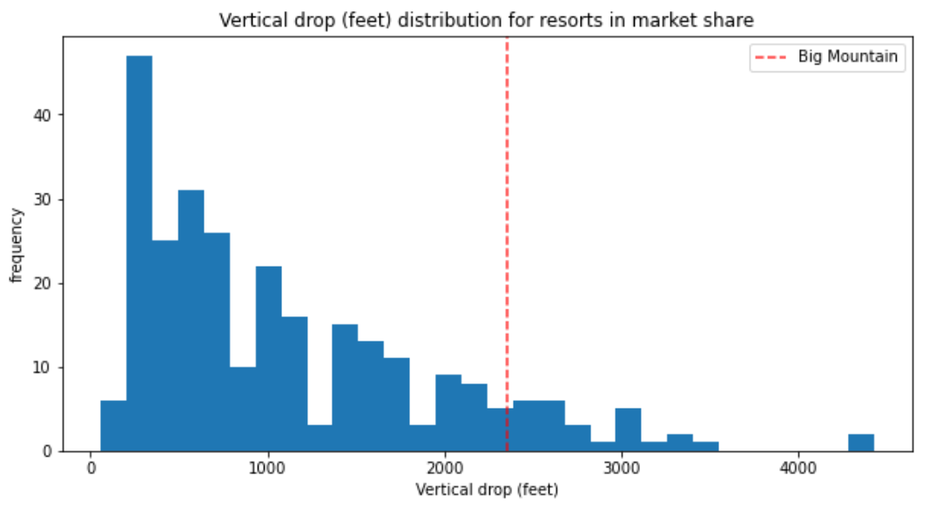
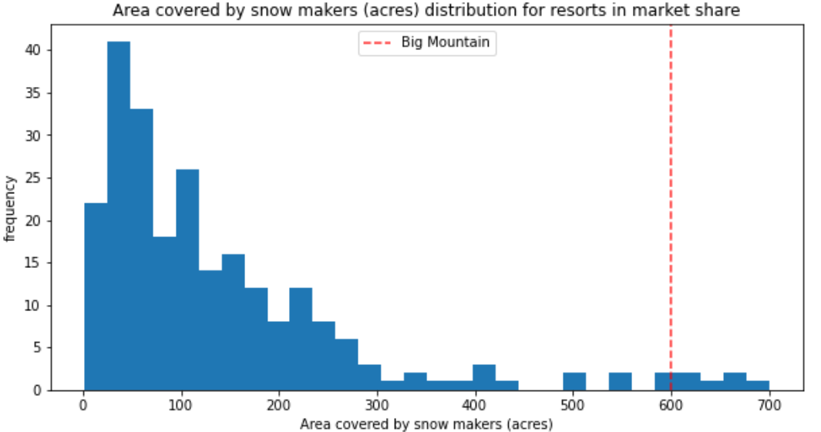
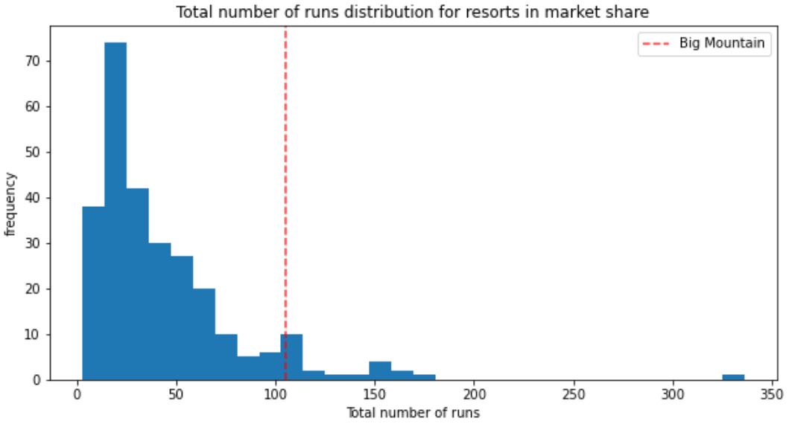
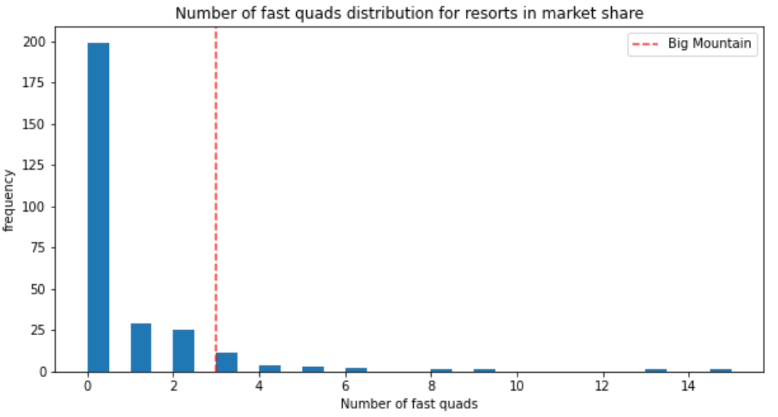
Modeling results and analysis

Slide 8
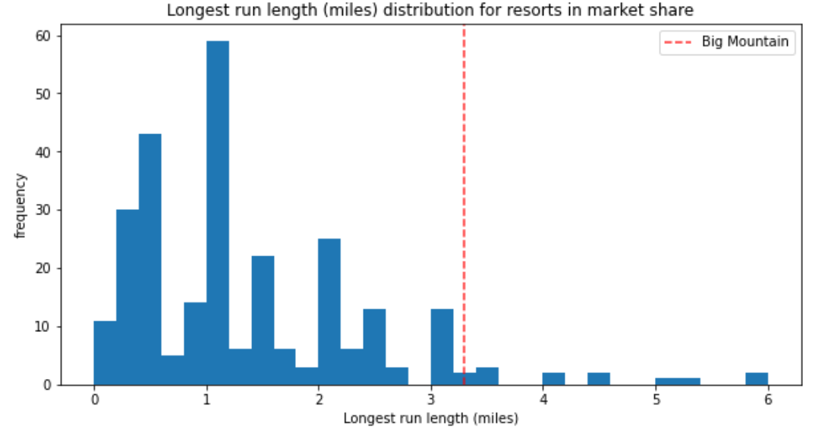
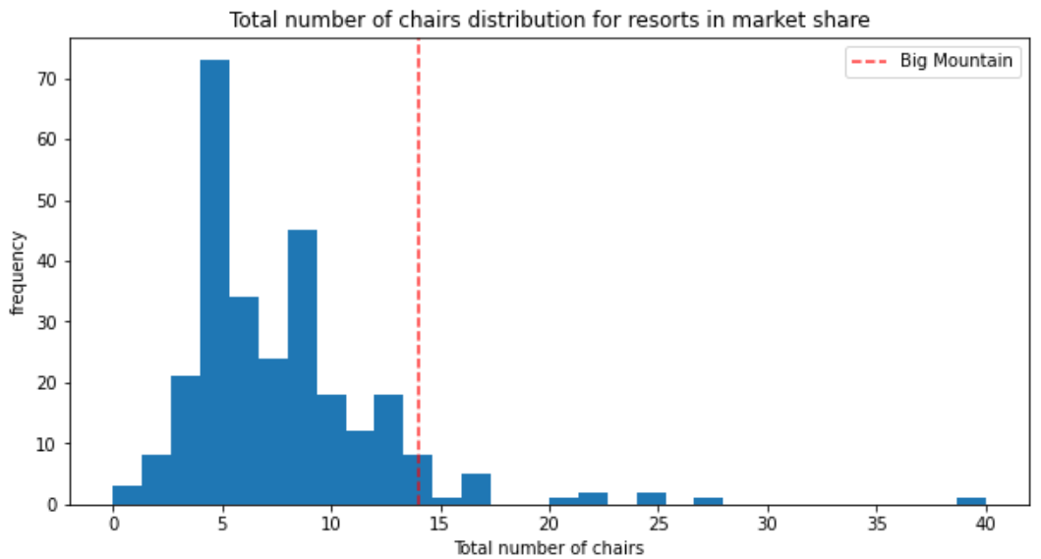
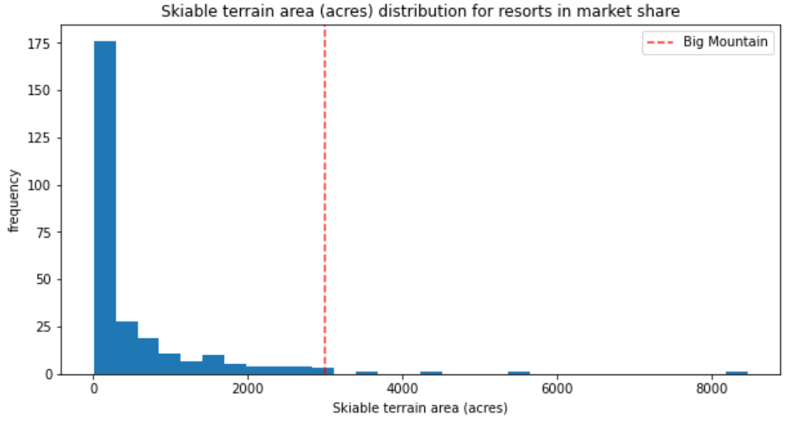
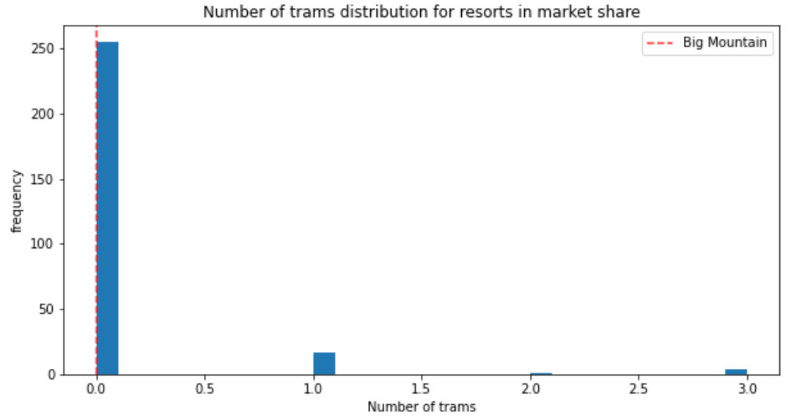
Modeling results and analysis

Slide 9
Modeling results and analysis
Four scenarios for the ticket price increase
Scenario #1: Permanently closing down up to 10 of the least used runs.
Scenario #2: Increase the vertical drop by adding a run to a point 150 feet lower down but requiring the installation of an additional chair lift to bring skiers back up, without additional snow-making coverage [BEST]
Scenario #3: Same as number 2, but adding 2 acres of snow-making cover
Scenario #4: Increase the longest run by 0.2 miles to boast 3.5 miles in length, requiring additional snowmaking coverage of 4 acres
Scenario | #1 | #2 | #3 | #4
Ticket price increase, $ | [-1.81,0] | 1.99 | 1.99 | 0
Revenue increase over the season, $ | [-3170289.85, 0] | 3,474,638 | 3,474,638 | 0

Slide 10
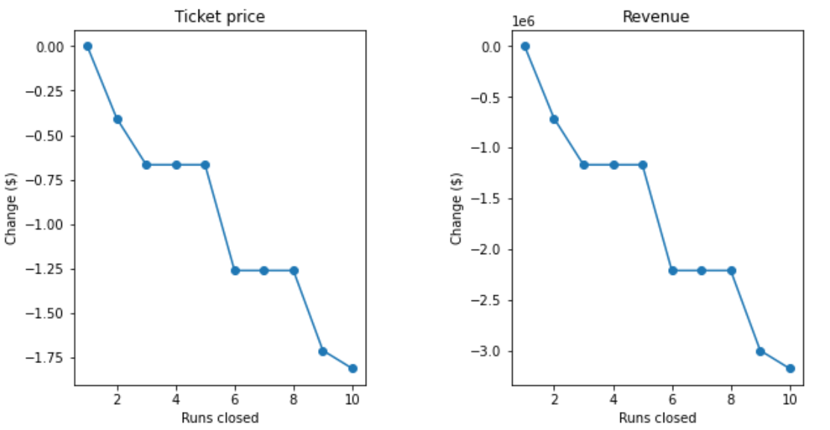
Modeling results and analysis
Scenario #1
The ticket price increase is negative.
Closing one run makes no difference.
Closing 2 and 3 successively reduces support for ticket price and so revenue
There is no further loss in the ticket price by closing 4 or 5 runs compared to 3 runs.
A large drop in ticket price or revenue will be caused if closing 6 or more runs.
Closing runs will cut the operational cost

Slide 11
Summary and conclusion
Project summary
The developed random forest model suggests increasing the ticket price from $81.00 to $82.99. This action can increase the revenue by 3.47 million, which can cover the additional operational cost of the new chair lift. The Big Mountain Resort can adopt the following measures to support the price lifting. (a). increasing the vertical drop by adding a run to a point 150 feet lower down. (b) installing an additional chair lift to bring skiers back up.
The proposed solution meets the success criteria. Considering one more chair lit is added, the increased revenue is still higher than the operational cost of two chair lifts.
If the operational cost of runs are given, we may further optimize the number of runs.
If the operational cost of other facilities are available, the model can be updated for new recommendations.
Conclusion & suggestions

Slide 12
Thank you

